Slide 1
Hate speech detection
By using NLP

Slide 2
introduction
Natural Language Processing (NLP) is a hotbed of research in data science these days and one of the most common applications of NLP is sentiment analysis.
Thousands of text documents can be processed for sentiment (and other features including named entities, topics, themes, etc.) in seconds, compared to the hours it would take a team of people to manually complete the same task.

Slide 3
procedure
Understand the Problem Statement
Tweets Preprocessing and Cleaning
Story Generation and Visualization from Tweets
Extracting Features from Cleaned Tweets
Model Building: Sentiment Analysis

Slide 4
NLP
Natural language process, it’s a branch of artificial intelligence
The computers ability understand text and spoken words in much the same way human begins can.
NLP combines computational linguistics rule-based modeling of human language with statistical, machine learning, and deep learning models

Slide 5

sentiment

Slide 6
objectives
The objective of this task is to detect hate speech in tweets. For the sake of simplicity, we say a tweet contains hate speech if it has a racist or sexist sentiment associated with it. So, the task is to classify racist or sexist tweets from other tweets.

Slide 7
Process:
Data collection
Data processing and cleaning
Data Visualization
feature extraction from cleaned tweets
Building model
Evaluation

Slide 8
libraries
Pandas
Numpy
Matplot
Sklearn
Nltk
seaborn

Slide 9
Data collection:
Data set collection…
Data set name:
train_E6oV3lV.csv
test_tweets_anuFYb8.csv

Slide 10
Data cleaning
Removing Twitter Handles (@user)
Removing Punctuations, Numbers, and Special Characters
Removing Short Words

Slide 11
Data processing
tokenization
Tokenization is the process of splitting a string of text into tokens
Stemming
Stemming is a rule-based process of stripping the suffixes
Example: ”ing”, “ly”, “es”, “s”

Slide 12
Visualization from Tweets
Common words uses in tweets – word cloud
Words in non racist/sexist tweet
Words in racist /sexist tweet
Understanding the impact of Hashtags on tweets sentiment
Non- racist/sexist
Racist/sexist

Slide 13
Feature extraction
Bag of word feature- countvectorizer
TF-IDF feature

Slide 14
Model building
For countvectorizer
For TF-IDF

Slide 15
algorithms
Logistic regression:
Supervised machine learning
It used solve the problem for classification and regression problem
It is used to calculate or predict the probability of a binary (yes/no) event occurring

Slide 16
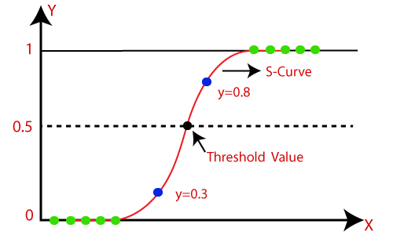
LR

Slide 17
Evaluation
Accuracy score calculation for best model for our particular target.

Slide 18


Slide 19


Slide 20


Slide 21

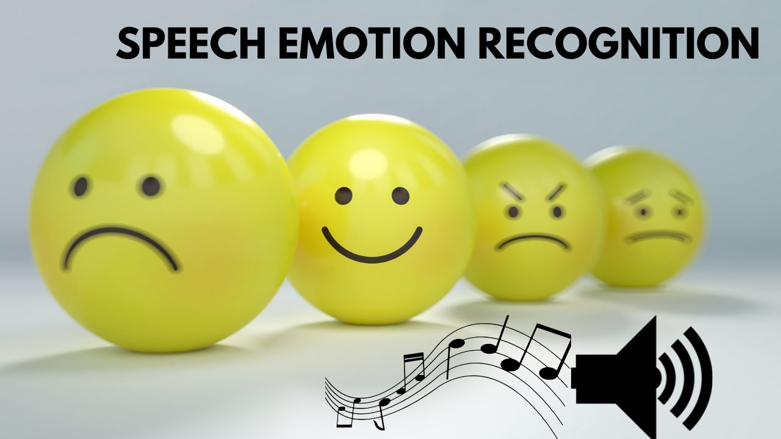



Slide 22

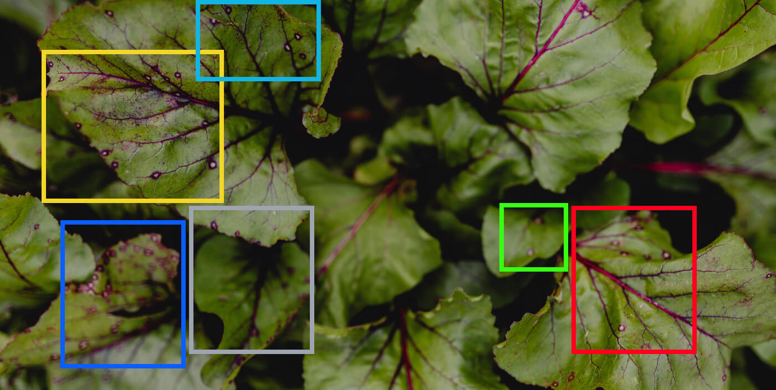

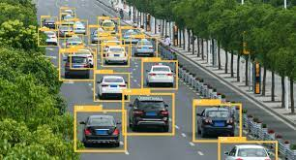

Slide 23

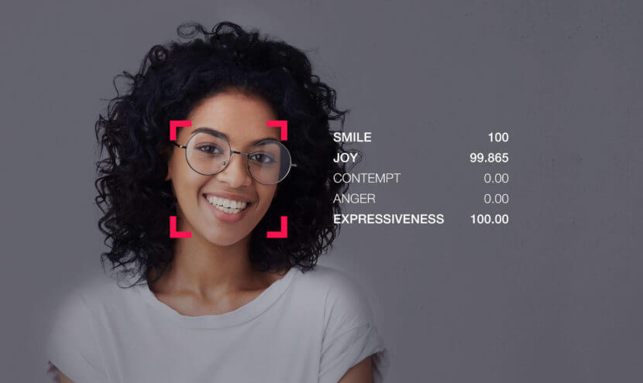
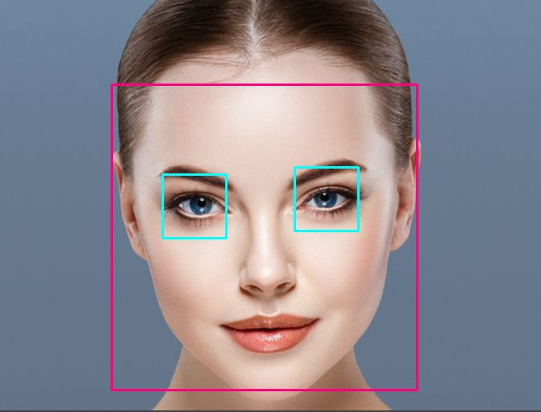


Slide 24


Slide 25
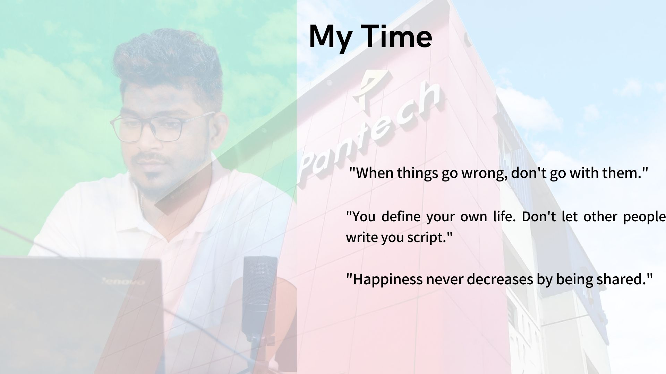

Slide 26
Thank you

